Slide 1
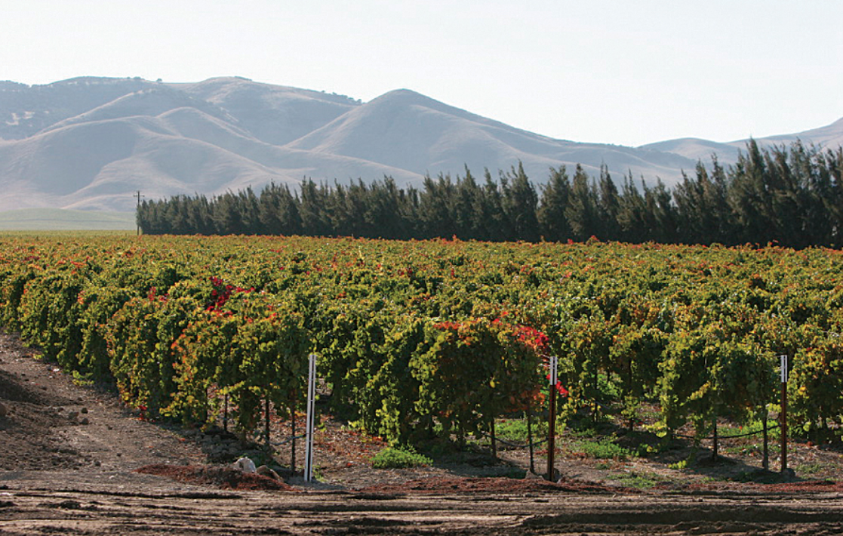
Agricultural-water use (AG) Package for gsflow
Hyper-resolution modeling of Regional water use by agriculture with integrated hydrology

Slide 2
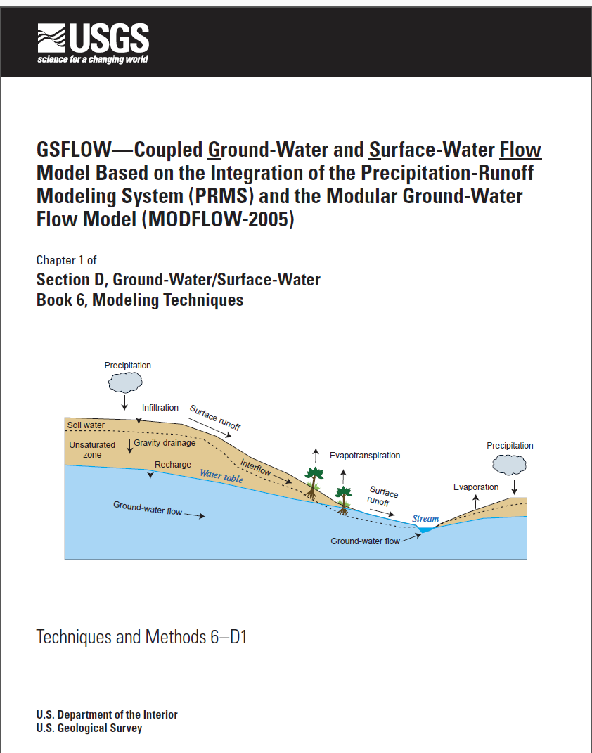
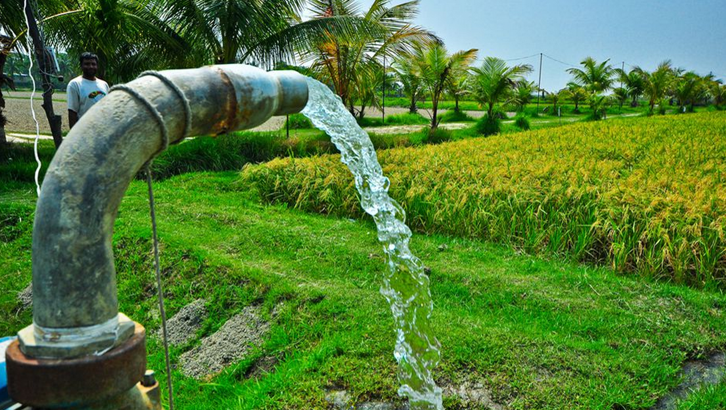
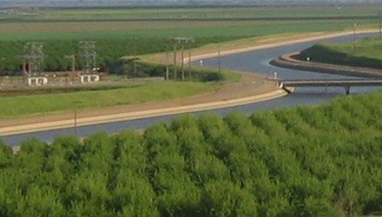
Agricultural-water use (AG) Package for gsflow
Developed using concept of Net Irrigation Water Requirement (NIWR)
How much water should be diverted/pumped to provide well watered conditions?
How does water supply limit consumption?
+

Slide 3

Agricultural-water use—at the intersection of supply and demand
Demand estimated using land use, climate, and ET deficit
Hydrology model simulates water supply
Competition among different water sectors (ag., muni, res., indus.)
Water Supply
Energy Demand

Slide 4
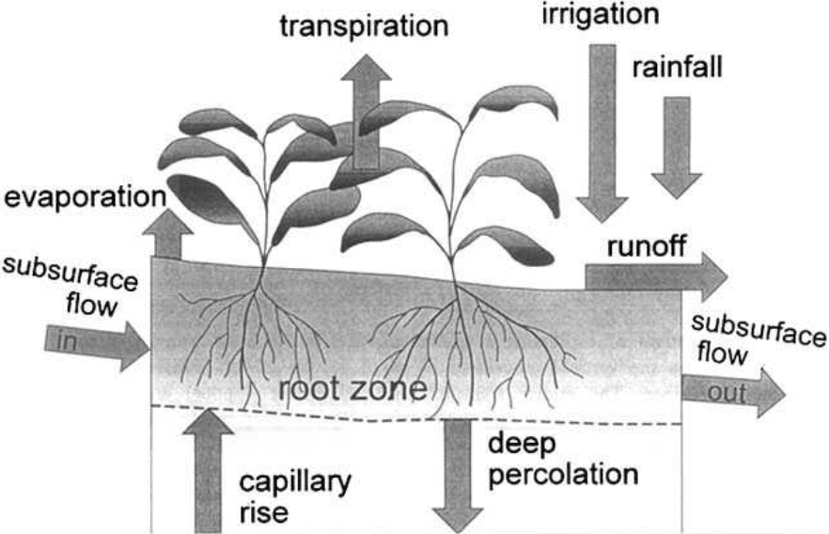

Energy and Soil-Water balance used to estimate NIWR
GSFLOW
Inverse problem: determine diversion/pumped amount (NIWR) by minimizing the ET deficit:
${min\left[{ET}_{def}\right]=ET}_{ww}−{ET}_{a}$ ,
ETww is the well-watered ET (e.g., Penman-Monteith)
ETa is the actual ET
ETa and actual irrigation is subject to water supply, irrigation schedule, and other constraints
--Irrigation processes happen automatically in GSFLOW

Slide 5
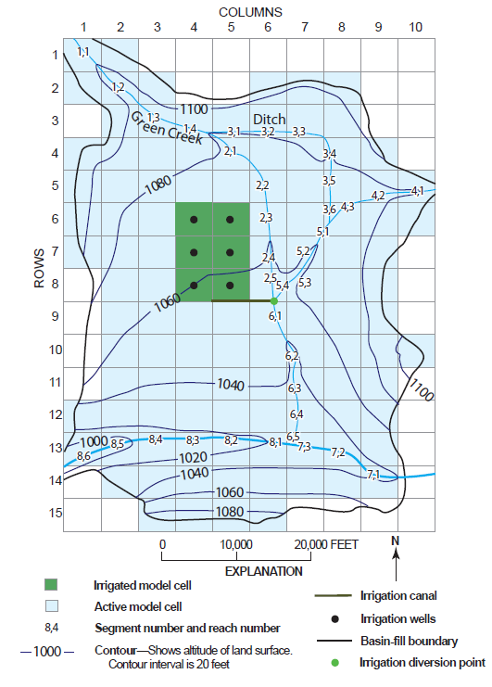
Example problem 1
MODFLOW-ONLY
Energy and water budget calculated by UZF Package

Slide 6
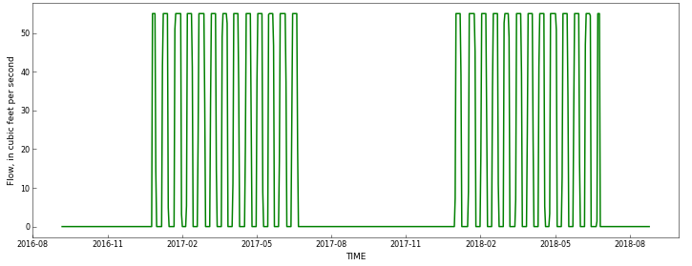
Imposed irrigation schedule (maximum SW diversions)
Irrigation is constrained to periods of non-zero flow shown by green line

Slide 7
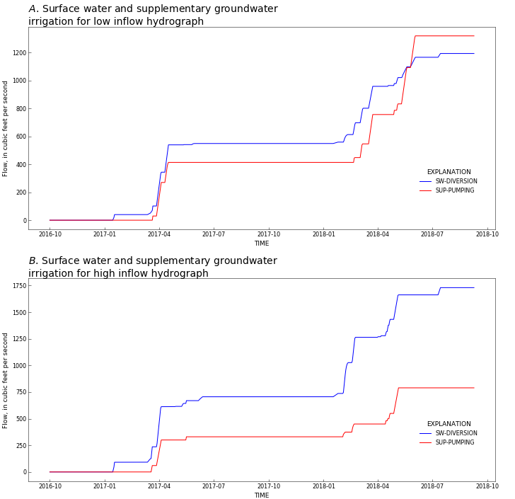
Conjunctive-USE of Surface water and groundwater
Dry climate
Moderate climate
SW diversions
SW diversions
GW Pumping
GW Pumping
More supplementary groundwater pumping for dry climate

Slide 8
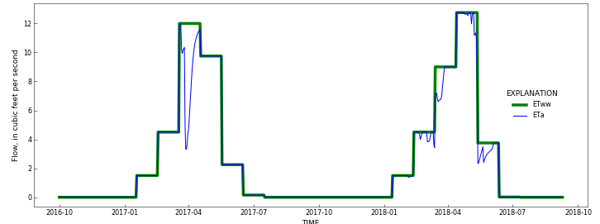
Imposed irrigation schedule results in deficit irrigation (ETa<ETww)

Slide 9
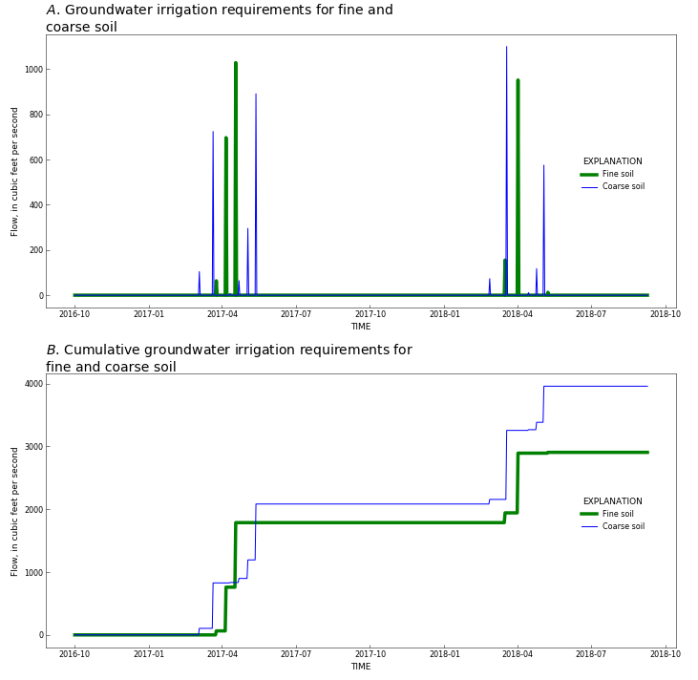
Impacts of field soil texture on NIWR (groundwater only)
Coarse soils require more irrigation due to rapid percolation below root zone

Slide 10
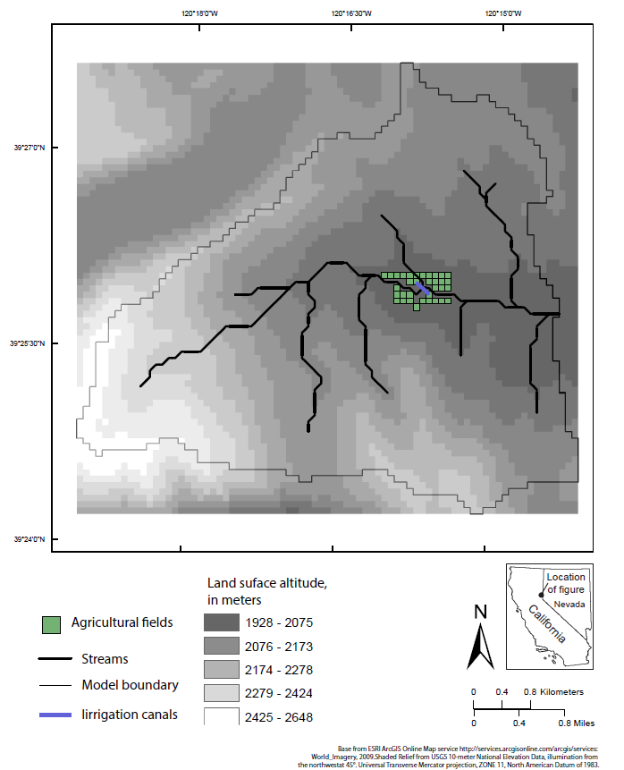
Example problem 2
GSFLOW
ENERGY AND SOIL-WATER BALANCE CALCULATED BY PRMS

Slide 11
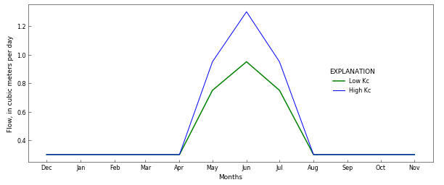
Example problem 2
Examine impacts of crop type (crop coefficient) on NIWR and crop consumption

Slide 12
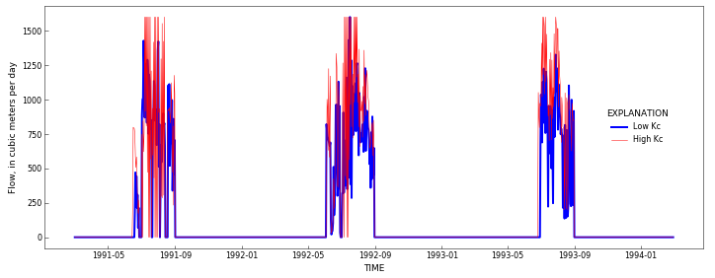
Example problem 2A: Irrigation amounts determined by minimizing ET deficit
NIWR for low and high crop coefficient (Kc) values

Slide 13
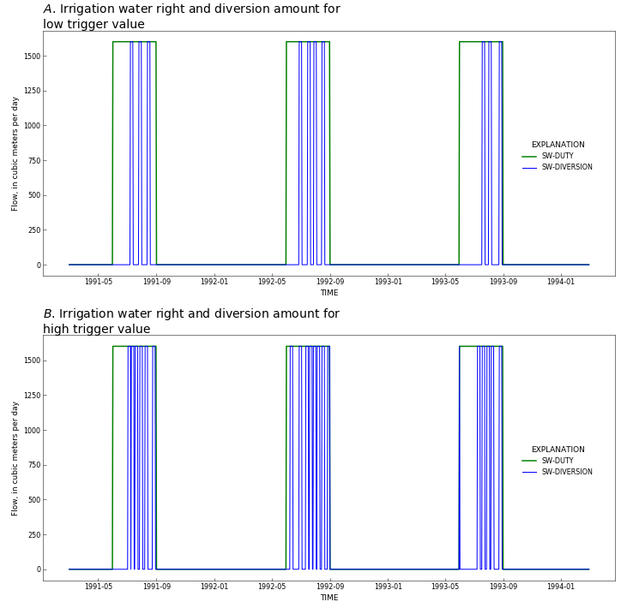
Example problem 2B: Irrigation events triggered by ET deficit with set duration and rate
Less irrigation events
More irrigation events

Slide 14
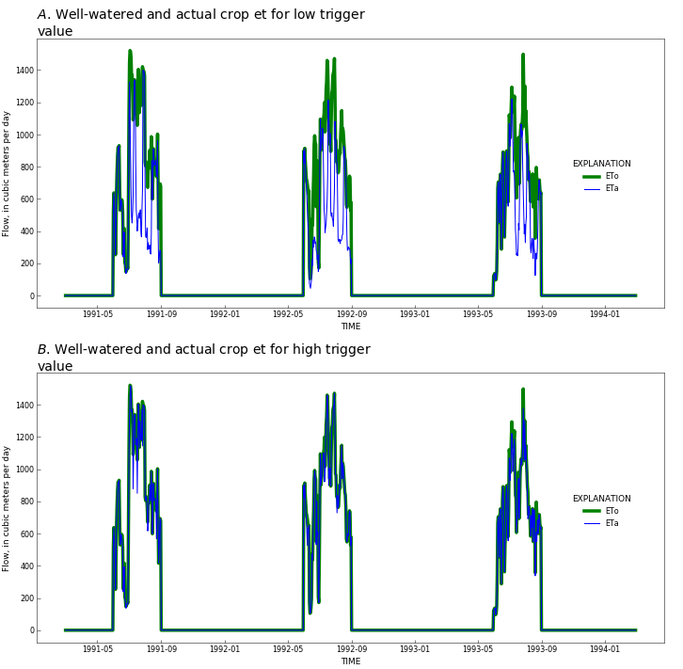
Example problem 2B: Different trigger thresholds affect et
Less irrigation events-deficit irrigation
More irrigation events-satisfy well water conditions

Slide 15
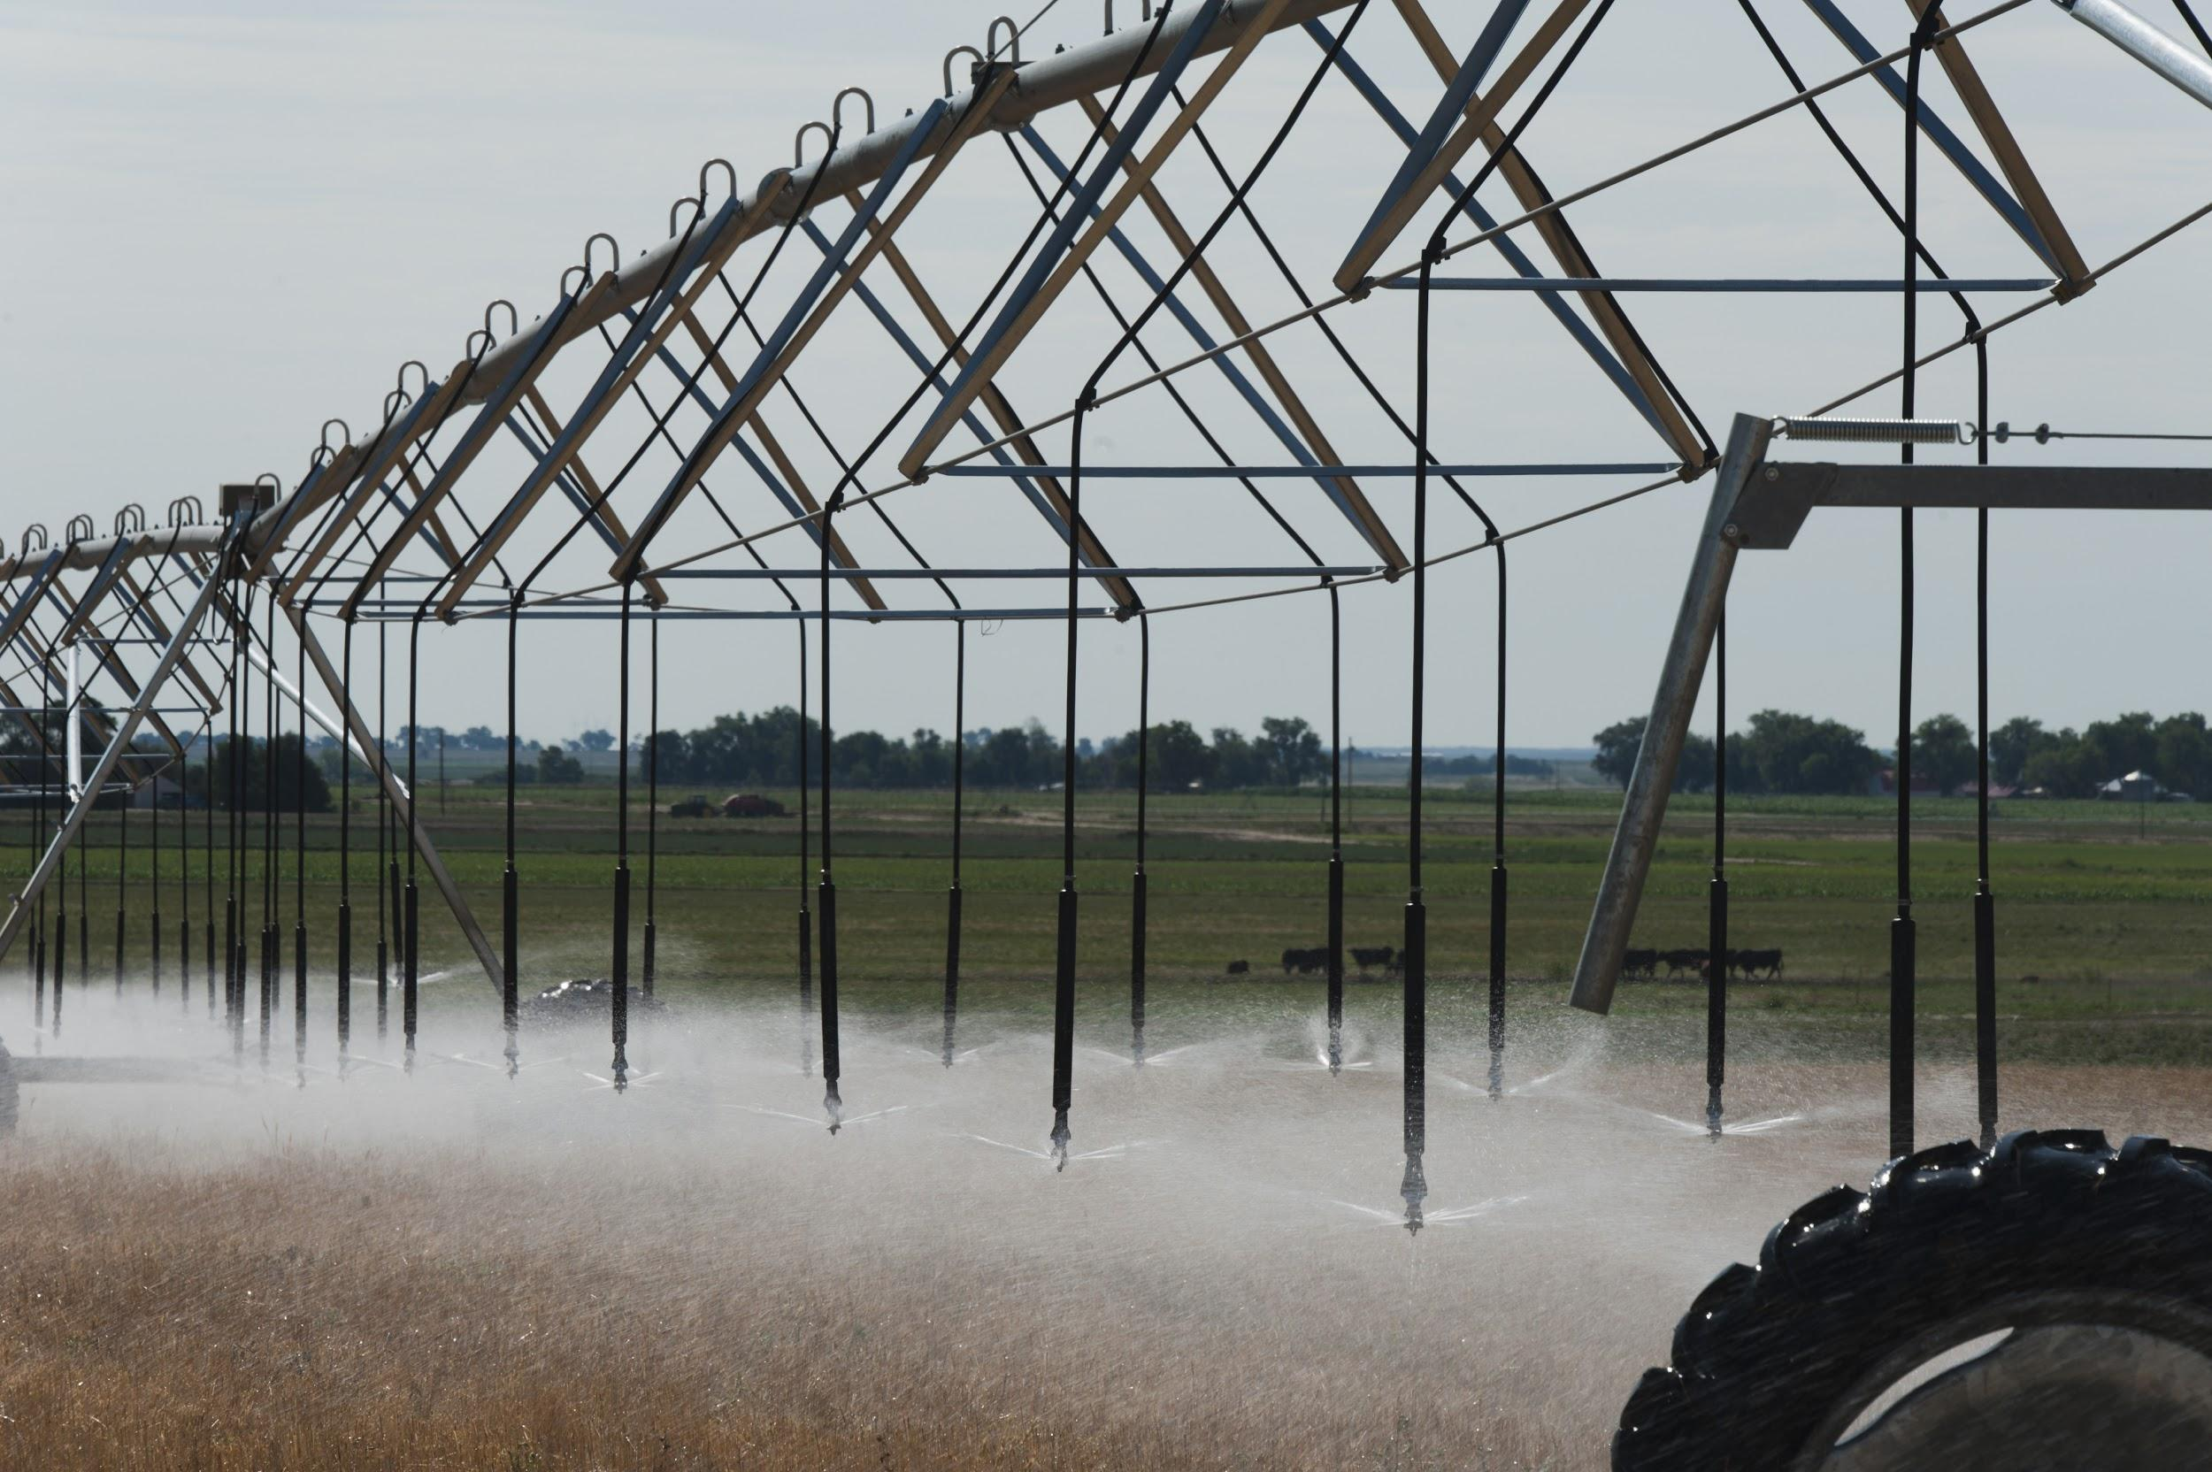
AG Package for gsflow
Automatically distributes water for irrigation using energy/water budget and mimics different types of grower behavior
Spatially distributed daily climate, energy and soil water balance, and lateral runoff simulation for return flows makes it unlike existing options for MODFLOW to simulate agriculture (e.g., OWHM-FARM)
Can evaluate impacts of climate change, and impacts of agriculture water use on low flows, groundwater levels, and reservoirs
Currently being applied in several high profile agricultural basins in California/Oregon/Nevada using MODSIM-GSFLOW

Slide 16
Submit to Environmental modeling and software Journal, 2-3 weeks
Release with GSFLOW in near future
Thanks!

Slide 17
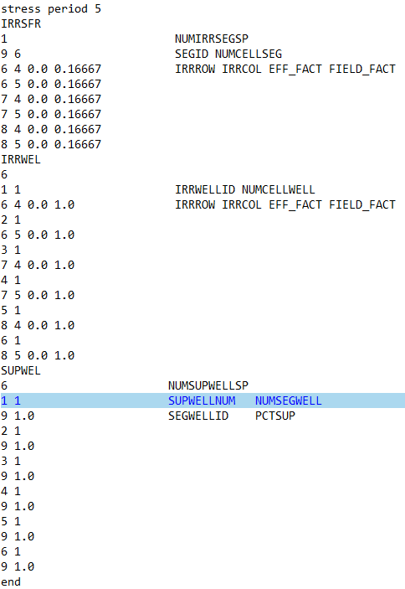
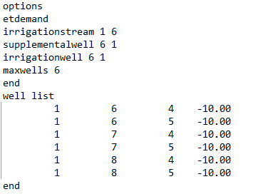
AG Package Input file structure (Key words)
Well list can use TABFILES to change max constraint on pumping

